Slide 1


Dasi Yashasvi
29-03-2025

Slide 2

Outline
Executive Summary
Introduction
Methodology
Results
Conclusion
Appendix

Slide 3
Executive Summary
This capstone predicts the Falcon 9 first-stage landing success using machine learning. I collected and cleaned launch data, performed exploratory analysis, and trained models. Decision trees achieved the highest accuracy. Insights from this study can help competitors assess launch costs and improve bidding strategies.
Initial findings suggest that probability of success has improved with time since 2013, as newer flight numbers proved to be more successful, and orbits ES-L1, GEO, HEO, SSO being highly successful while SO and GTO saw the least success. Launch stations like KSC saw the most success.
I dealt as to find the factors which were affecting the above results

Slide 4
Introduction
SpaceX advertises Falcon 9 rocket launches on its website with a cost of 62 million dollars; other providers cost upward of 165 million dollars each, much of the savings is because SpaceX can reuse the first stage. Therefore if we can determine if the first stage will land, we can determine the cost of a launch. This information can be used if an alternate company wants to bid against SpaceX for a rocket launch.
Answer to the questions like what all factors affect the success of a mission
Success rate which will tell us if the upcoming launch will be successful of not referencing to the previous launches
Factors which doesn’t affect the success of a mission such that spaceX can reduce their cost of launches

Slide 5

Section 1

Slide 6
Methodology
Executive Summary
Data collection methodology:
Data was scraped from Wikipedia and spaceX official API using requests and parsed using beautifulSoup
Performed data wrangling
After the API response was cleaned, parsed and converted into a dataframe, the null values in payload mass were replaced by the mean of the overall payload mass
Performed exploratory data analysis (EDA) using visualization and SQL
Performed interactive visual analytics using Folium and Plotly Dash
Performed predictive analysis using classification models
Comparing Logistic Regression, SVM, Decision Tree, K-nearest neighbour algorithms

Slide 7
Data Collection
The data collection involved two primary methods:
Web Scraping from Wikipedia
Source: "List of Falcon 9 and Falcon Heavy launches" Wikipedia page
Tool: BeautifulSoup library in Python
Data extracted: Launch records including dates, booster versions, payloads, outcomes
https://en.wikipedia.org/wiki/List_of_Falcon_9_and_Falcon_Heavy_launches
SpaceX API Requests
Multiple endpoints used to gather detailed information
Collected data about rockets, payloads, launchpads, and cores
Enriched dataset with technical specifications and outcomes
https://api.spacexdata.com/v4/cores/

Slide 8
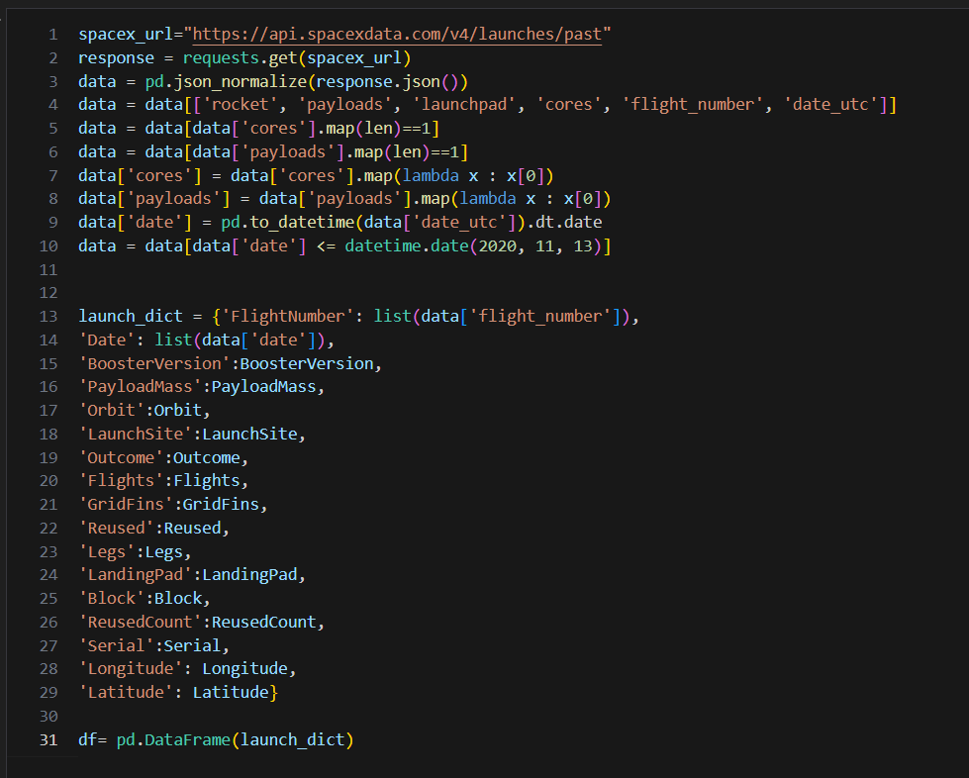
Data Collection – SpaceX API
SpaceX API
Initial request to SpaceX API's past launches endpoint
JSON data normalized into pandas Data Frame
Core information filtered to focus on relevant data points
Additional API requests for detailed information about:
Booster specifications
Launch site coordinates
Payload mass and orbit
Core landing details
Github link: DataAnalysisCapstone/jupyter-labs-spacex-data-collection-api.ipynb at main · Yashasvidasi/DataAnalysisCapstone

Slide 9
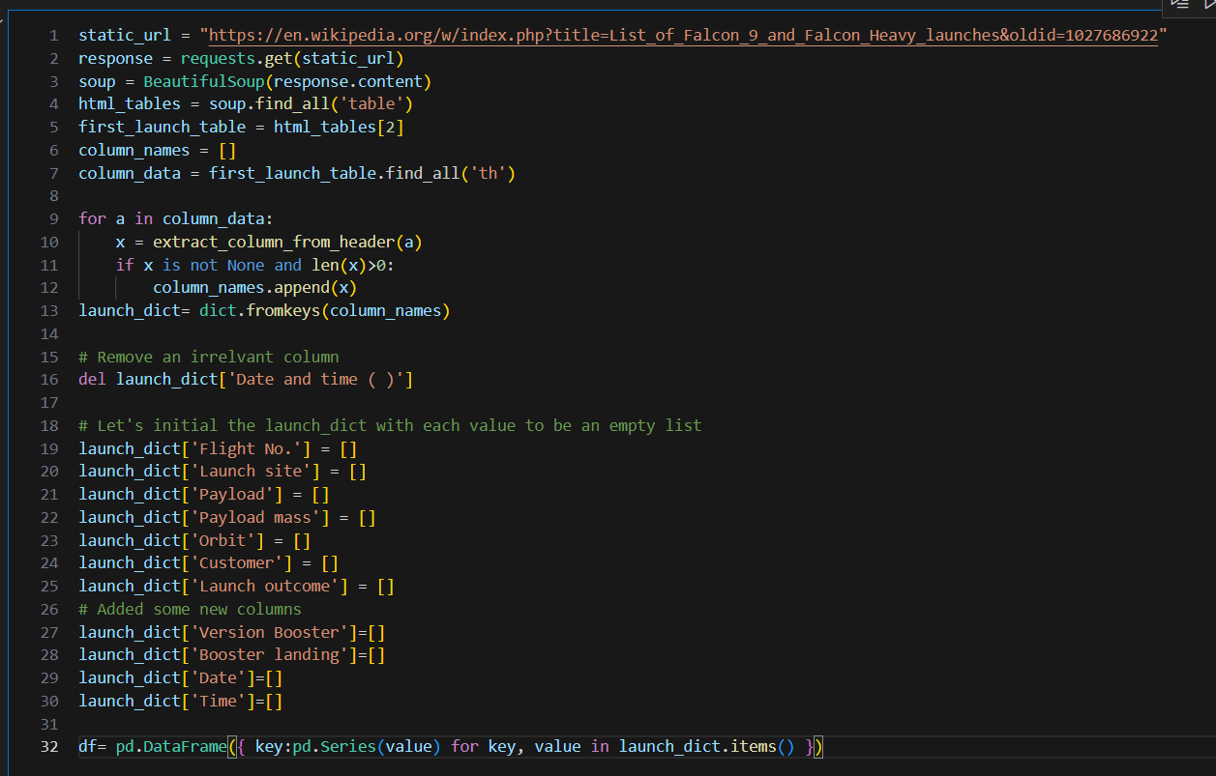
Data Collection - Scraping
Wikipedia Web Scraping
HTTP GET request to Wikipedia page snapshot
BeautifulSoup used to parse HTML content
Helper functions created to extract specific data points from table cells
Extraction of flight numbers, dates, booster versions, and landing outcomes
Github link: DataAnalysisCapstone/jupyter-labs-webscraping.ipynb at main · Yashasvidasi/DataAnalysisCapstone

Slide 10
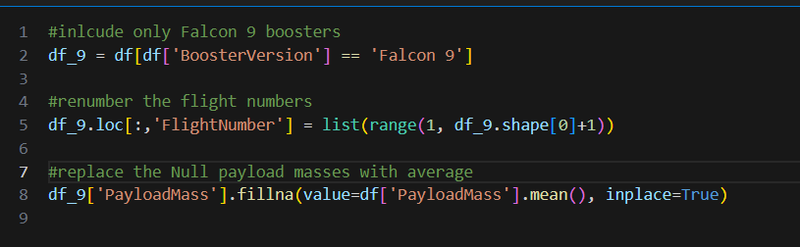
Data Wrangling
Selecting only Falcon 9 boosters and storing them in a new Data Frame called df_9.
Reassigning flight numbers for the Falcon 9 boosters, to ensure a sequential numbering system starting from 1.
Replacing any 26 null values in the 'PayloadMass' column with the mean payload mass, ensuring there are no missing values for this attribute.

Slide 11
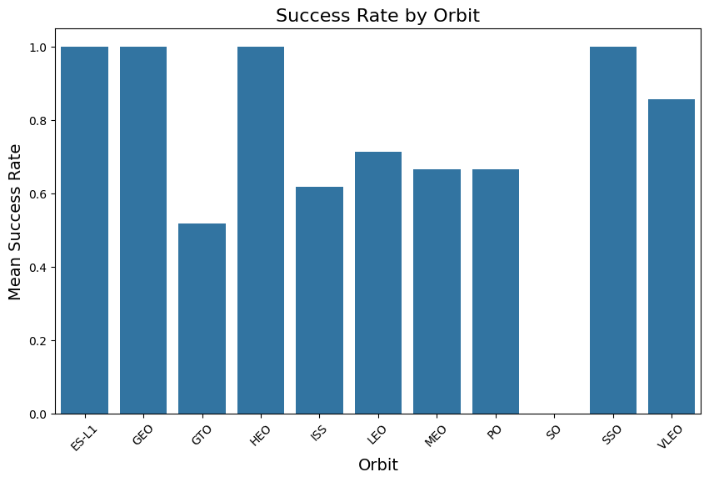
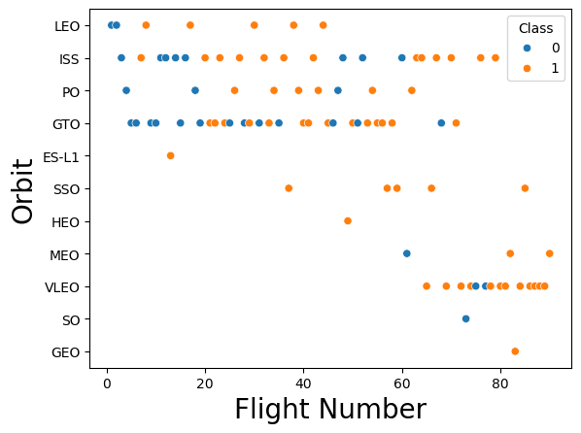
EDA with Data Visualization
SSO, HEO, GEO, ES-L1 were mostly successful but HEO, GEO, ES-L1 saw only 1 mission which was a success, so we can’t say for sure they are reason for success of launch, in that rate SSO saw success 5 out of 5 times being a better indicator. In the LEO, VLEO orbit, success seems to be related to the number of flights. Conversely, in the GTO orbit, there appears to be no relationship between flight number and success. Lastly SO saw only 1 mission which was a failure so we can’t say for sure SO is reason for failure of launch.
Github link: DataAnalysisCapstone/edadataviz.ipynb at main · Yashasvidasi/DataAnalysisCapstone

Slide 12
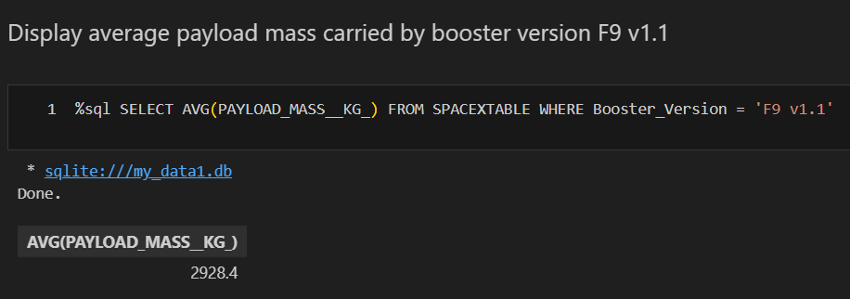
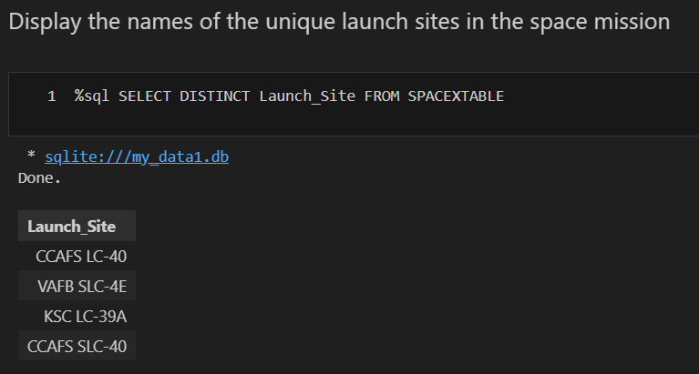
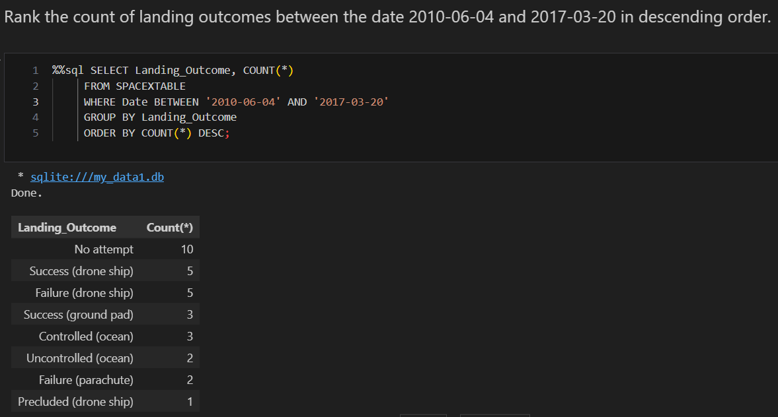
EDA with SQL
Finding the average mass for spaceX missions, Failure and success of landings count, unique launch sites to get a better scope of the data we are dealing with.
Github link: DataAnalysisCapstone/jupyter-labs-eda-sql-coursera_sqllite.ipynb at main · Yashasvidasi/DataAnalysisCapstone

Slide 13
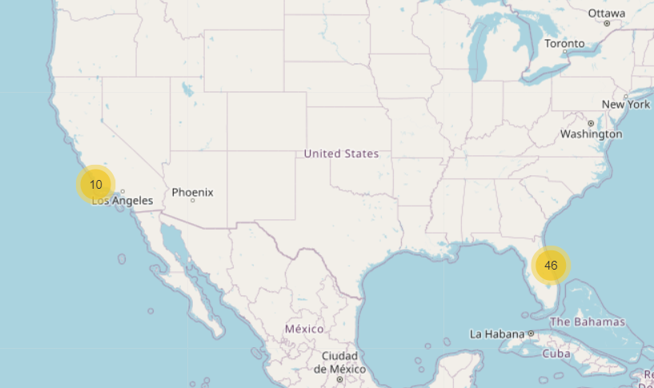
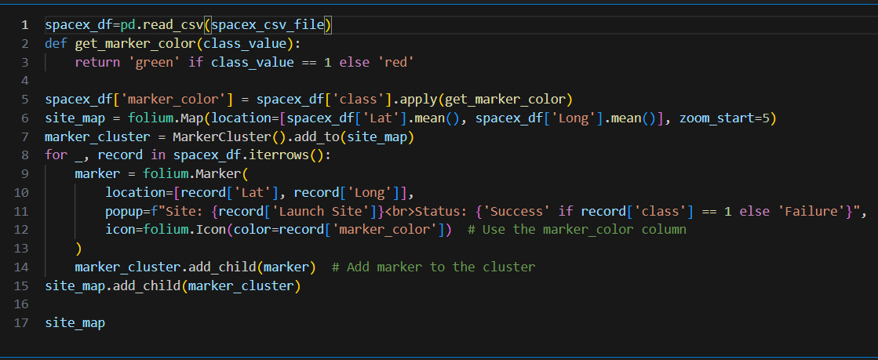
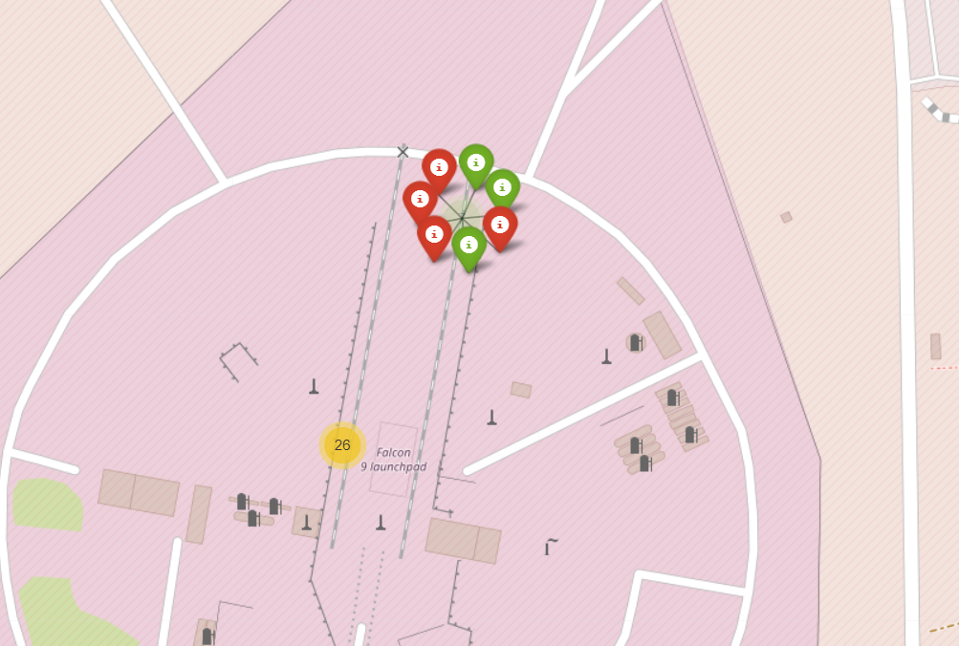
Build an Interactive Map with Folium
If a launch was successful `(class=1)`, then we use a green marker and if a launch was failed, we use a red marker `(class=0)`. Geolocation helps us to visualize the real-world location and the though process of selecting the location for building a launch pad
Github: DataAnalysisCapstone/lab_jupyter_launch_site_location.ipynb at main · Yashasvidasi/DataAnalysisCapstone

Slide 14
Build a Dashboard with Plotly Dash
I have used :
Total successful launch ratios for each site
Success vs failure ratios for each site
Payload vs success for each site for variable ranges
Analyzing total successful launch ratios helps identify the most reliable sites, ensuring efficient resource allocation and improved launch strategies. Comparing success vs. failure ratios highlights potential risks, allowing for better failure mitigation and site optimization. Examining payload vs. success rates reveals site-specific capabilities, ensuring the right locations are chosen for different payload ranges. Together, these analyses enhance decision-making, improve reliability, and optimize future space missions.
Github link: DataAnalysisCapstone/spacex-dash-app.py at main · Yashasvidasi/DataAnalysisCapstone

Slide 15
Predictive Analysis (Classification)
Flow of the Machine Learning Project
The notebook aims to predict whether SpaceX's Falcon 9 first stage will land successfully, which directly impacts launch costs.
The dataset contains information about past Falcon 9 launches with various features like flight number, payload mass, orbit type, and landing outcomes.
The target variable 'Class' indicates landing success (1) or failure (0).
The data was preprocessed by standardizing features using Standard Scaler.
The dataset was split into training (80%) and testing (20%) sets with a random state of 2.
Results and Model Performance
Linear Regression: tuned hyperparameters :(best parameters) {'C': 0.01, 'penalty': 'l2', 'solver': 'lbfgs’} accuracy : 83.33%
SVM: tuned hyperparameters :(best parameters) {'C': 1.0, 'gamma': 0.03162277660168379, 'kernel': 'sigmoid’}, accuracy: 83.33%
tuned hyperparameters :(best parameters) {'criterion': 'gini', 'max_depth': 6, 'max_features': 'sqrt', 'min_samples_leaf': 2, 'min_samples_split': 2, 'splitter': 'random’}, accuracy: 88.88%
KNN: tuned hyperparameters :(best parameters) {'algorithm': 'auto', 'n_neighbors': 10, 'p': 1}, accuracy: 83.33%
Github :DataAnalysisCapstone/SpaceX_Machine Learning Prediction_Part_5.ipynb at main · Yashasvidasi/DataAnalysisCapstone

Slide 16
Results
SSO, HEO, GEO, ES-L1 were mostly successful but HEO, GEO, ES-L1 saw only 1 mission which was a success, so we can’t say for sure they are reason for success of launch, in that rate SSO saw success 5 out of 5 times being a better indicator. In the LEO, VLEO orbit, success seems to be related to the number of flights. Conversely, in the GTO orbit, there appears to be no relationship between flight number and success. Lastly SO saw only 1 mission which was a failure so we can’t say for sure SO is reason for failure of launch.
Launch sites are located in distant locations, like Cape Canaveral Space Force Station (CCSFS) and Kennedy Space Center (KSC) in Florida are situated along the Atlantic coast, providing direct access to supply chains and transportation routes while maintaining a safe distance from densely populated areas. Their coastal location allows for eastward launches over the ocean, reducing the risk of debris falling over land. Additionally, launch sites are typically positioned away from major railroads and civilian infrastructure to prevent accidents and minimize disruptions.
Decision tree was the highest accuracy with tuned hyperparameters :(best parameters) {'criterion': 'gini', 'max_depth': 6, 'max_features': 'sqrt', 'min_samples_leaf': 2, 'min_samples_split': 2, 'splitter': 'random’}, accuracy: 88.88%

Slide 17

Section 2

Slide 18
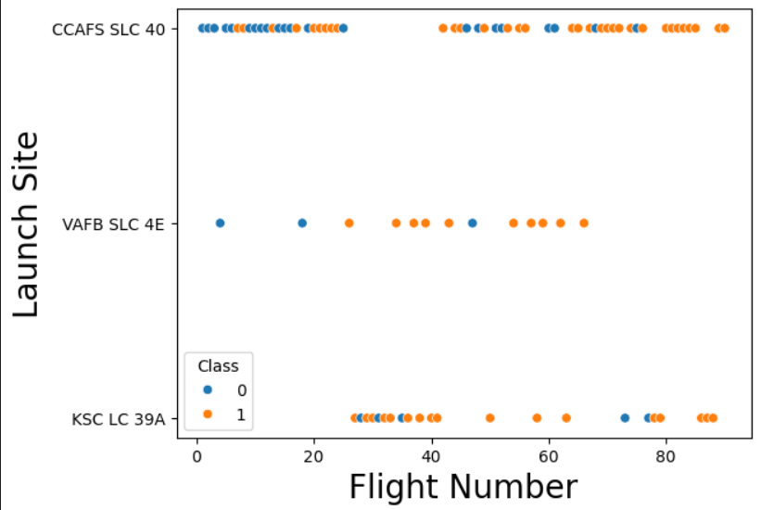
Flight Number vs. Launch Site
CCAFS SLC 40 has the highest number of launches, showing a mix of successes and failures, but success rates improve over time.
KSC LC 39A has a high success rate, with most flights being successful, likely due to its use for critical missions.
VAFB SLC 4E has fewer launches and a lower success rate, possibly due to different mission profiles like polar orbits.

Slide 19
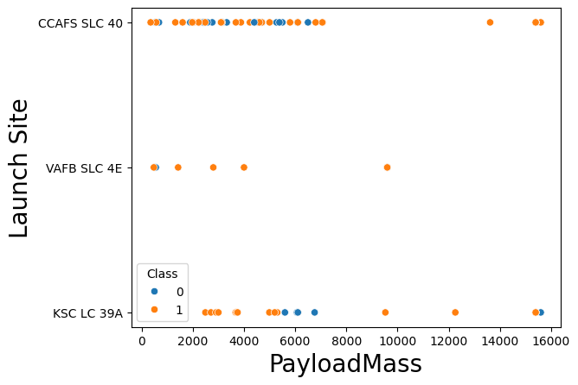
Payload vs. Launch Site
The chart shows payload mass distribution across three launch sites - CCAFS SLC 40 (Cape Canaveral Air Force Station Space Launch Complex 40), VAFB SLC 4E (Vandenberg Air Force Base Space Launch Complex 4E), and KSC LC 39A (Kennedy Space Center Launch Complex 39A).
The payload masses range from approximately 0 to 16,000 units (likely kilograms). Most launches across all sites carry payloads under 8,000 units, with CCAFS SLC 40 showing the most consistent launch activity. There are a few heavier payloads (12,000-16,000 range) primarily launched from CCAFS SLC 40 and KSC LC 39A.
VAFB SLC 4E saw most of the success also the average mass of payload is much lower than rest of the 2

Slide 20
Success Rate vs. Orbit Type
Perfect Success Rates: Several orbits (ES-L1, GEO, HEO, and SO) show a 100% success rate, indicating flawless mission execution for these specific orbital destinations.
Lowest Success Rate: The GTO (Geostationary Transfer Orbit) has the lowest success rate among all orbits, at approximately 52%, suggesting it may be the most challenging orbit to achieve.
Varied Performance: Other orbits like ISS, LEO, MEO, and PO show success rates ranging from about 65% to 75%, indicating room for improvement in mission reliability for these destinations.

Slide 21
Flight Number vs. Orbit Type
We can see as the flight number increased the spaceX targeted orbits such as MEO, VLEO, SO, GEO
They stopped targeting LEO after 45 flight number
Only 1 mission to GEO
SSO was most successful
GEO was the newest destination
SpaceX concentrated on VLEO mostly in recent Flight Launches and was fairly successful

Slide 22
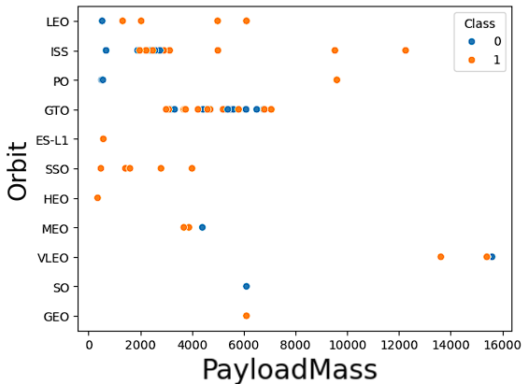
Payload vs. Orbit Type
Higher payload masses (above ~10,000 kg) are predominantly associated with successful launches (Class 1), especially in GTO and GEO orbits.
Certain orbits like LEO and ISS show a mix of success (Class 1) and failure (Class 0), while others like GEO and SO have fewer data points but are mostly successful.
Lower payload masses (<5,000 kg) exhibit varied outcomes across different orbits, indicating that success is influenced by factors beyond payload mass alone.

Slide 23
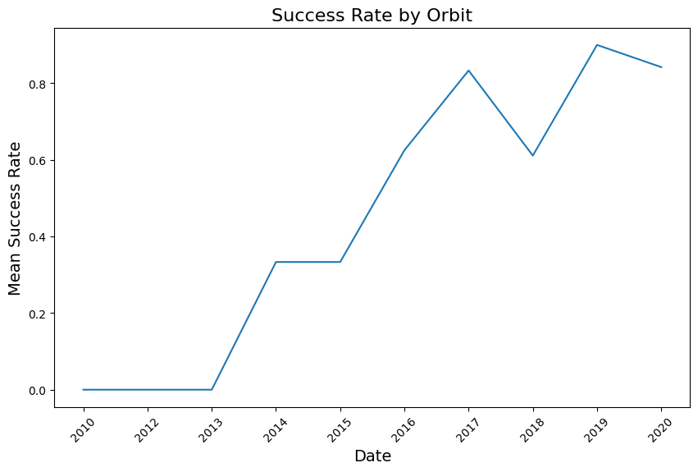
Launch Success Yearly Trend
The mean success rate has shown a steady increase from 2013 to 2019, indicating significant advancements in orbital launch reliability over time.
Peak Performance: The highest success rate was achieved around 2019, nearing 90%, followed by a slight decline in 2020.
There was dip in success rate during 2018 probably due to the shift to the newer version of falcon 9 booster
Dip in 2020 is probably due to covid

Slide 24
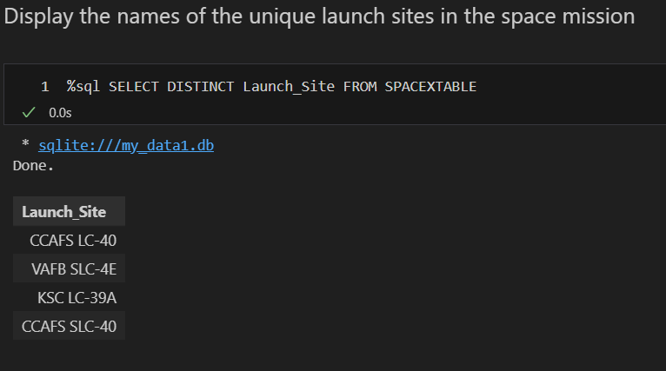
All Launch Site Names
CAAFS LC-40 (Cape Canaveral Air Force Launch Complex 40)
VAFB SLC-4E (Vandenberg Air Force Base Space Launch Complex 4 East)
KSC LC-39A (Kennedy Space Center Launch Complex 39A)
CAAFS SLC-40 (Cape Canaveral Air Force Space Launch Complex 40)
First and the last are the same hence merged in later queries

Slide 25
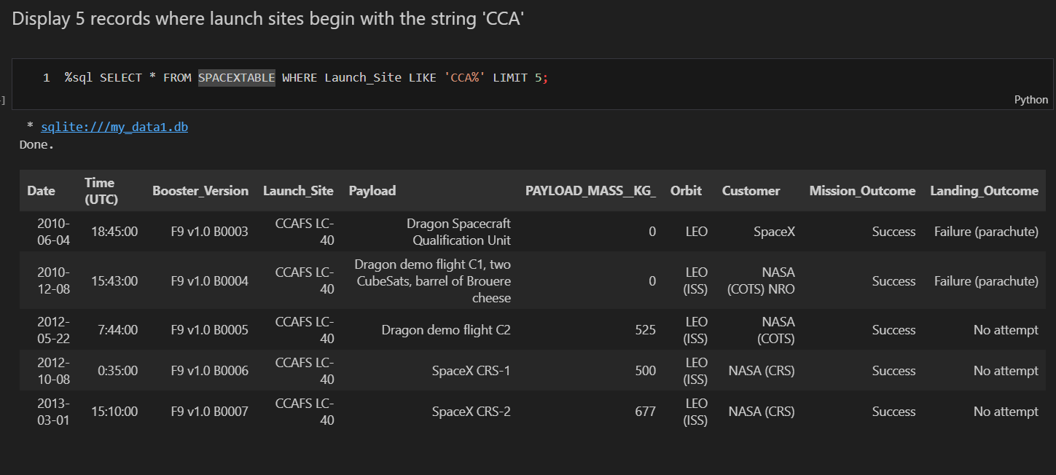
Launch Site Names Begin with 'CCA'
We got 2 rocket launches of 2010 with payload mass 0 kg both landings were failures
2 more on 2012, they didn’t attempt to land them with approx. 500kg payload both carried out by nasa
Another 1 by nasa on 2013 with a payload of 677 kg
All of the launches destinations were ISS (international space station)

Slide 26
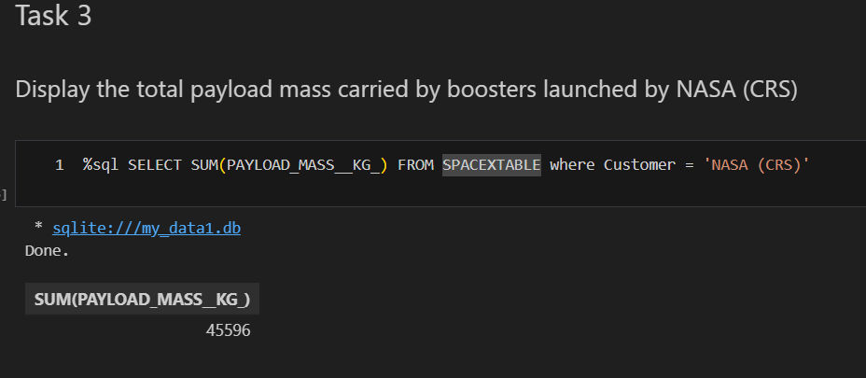
Total Payload Mass
Total Payload of 45596kg were carried out
CRS (commercial Resupply Services) they are carried out by NASA to Resupply the astronauts and gear in the international space station ISS mostly targeted on the LEO orbit.

Slide 27
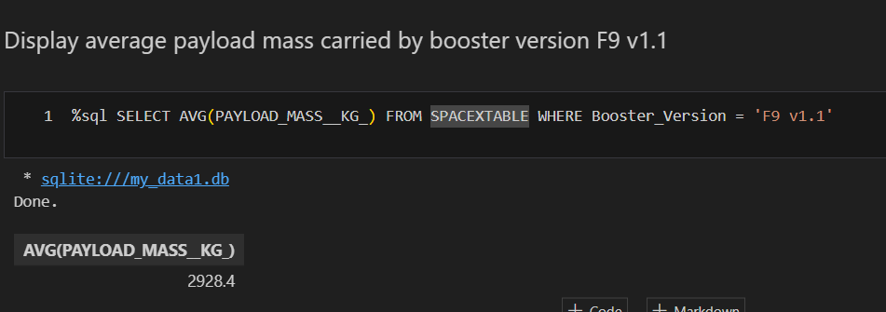
Average Payload Mass by F9 v1.1
V1.1 carried out average of 2928.4KG
While the overall average was around 6000 kg so booster F1 V1.1 was is less effective in carrying out heavy payload to the space

Slide 28
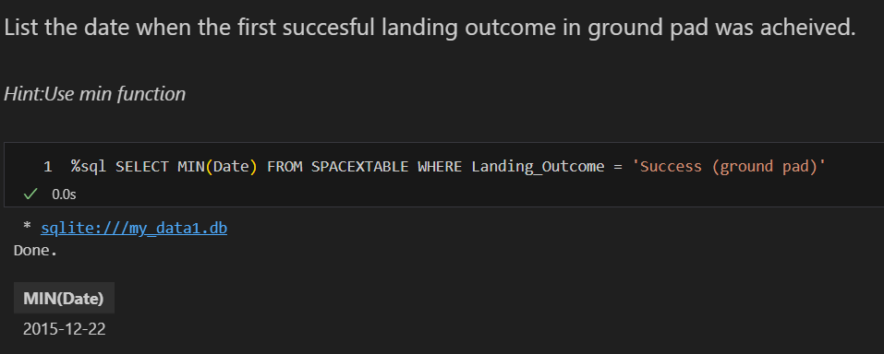
First Successful Ground Landing Date
Date: 2015-12-22 recorded the successful landing on ground pad
The Data we have is from 2010, but the first successful landing on the ground pad happened in 2015, nearly 6 year after the earliest launch record

Slide 29
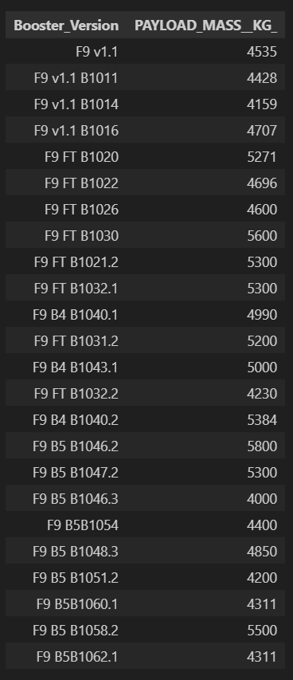
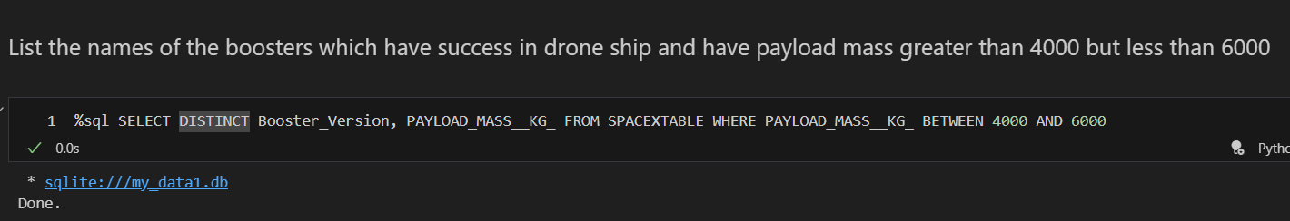
Successful Drone Ship Landing with Payload between 4000 and 6000
There are a total of 24 distinct Boosters which were able to carry a payload greater than 4000 and less than 6000
Majority of them being the B5 and FT boosters, there is no order to them, both of the versions carried out payload similarly, while V1.1 carried out towards the lower end of the payload mass.

Slide 30
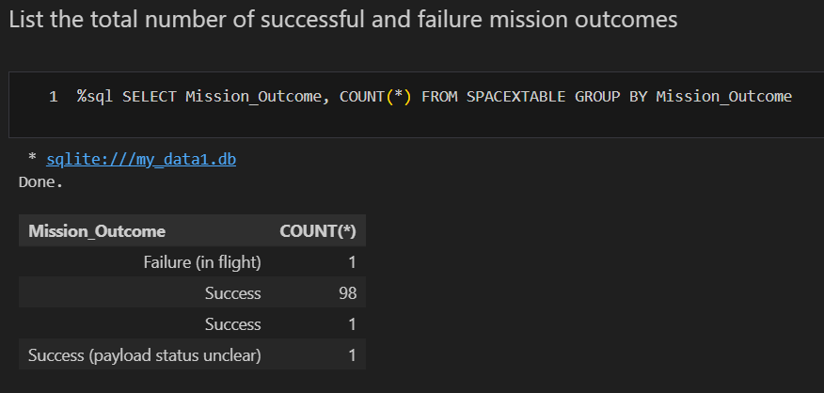
Total Number of Successful and Failure Mission Outcomes
Missions were dominantly successful only failure were during landing, this shows that Rocket launches are safer and most of the risk is in landing the rocket safely

Slide 31
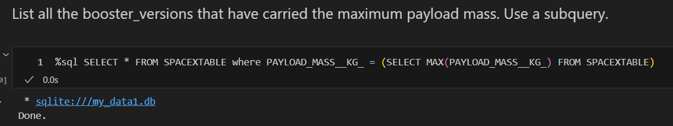
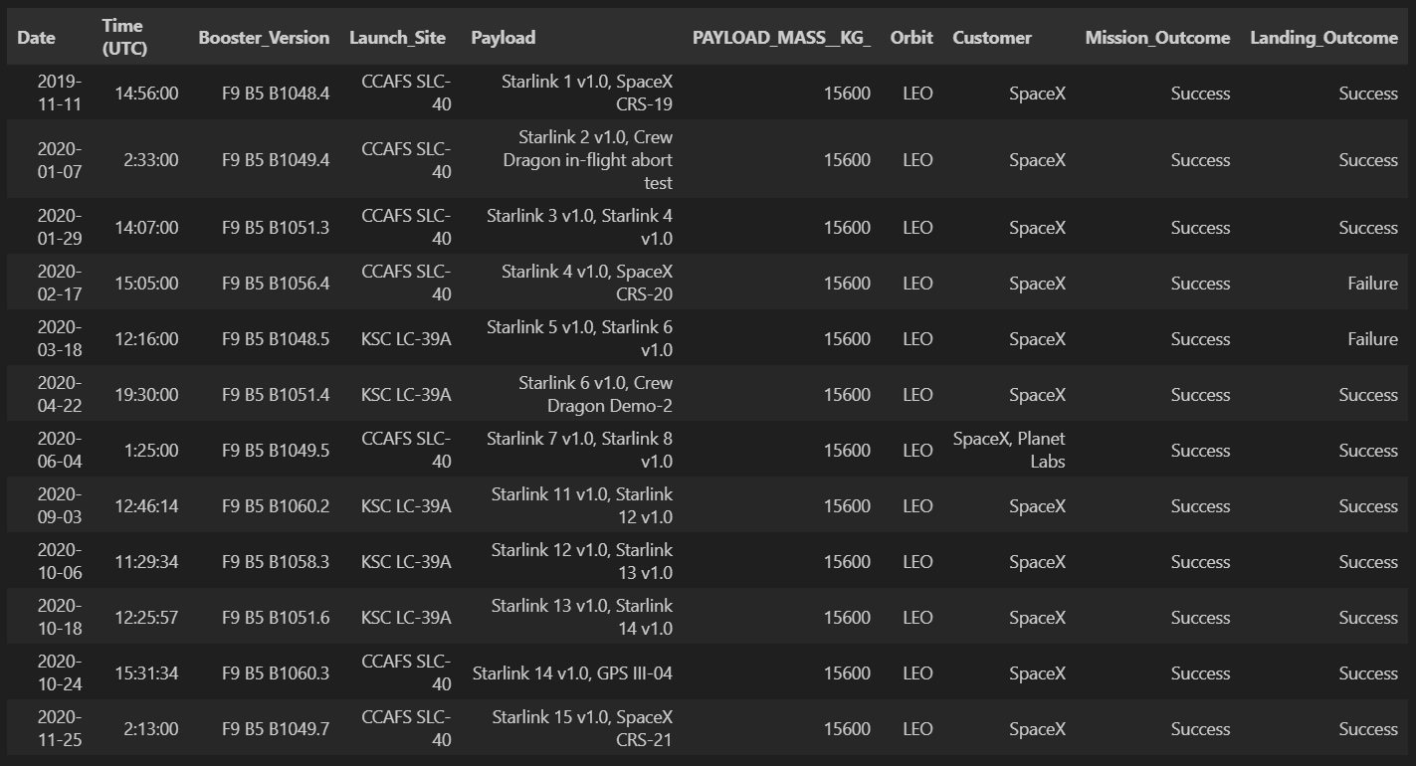
Boosters Carried Maximum Payload
There were a total of 12 such launches, Where the payload was maximum of 15600 Kg, all of them were carried out by the F9 B5 boosters, and were predominantly successfully carried out by spaceX, with only 2 failures of landing out of 12. All of them were target to LEO orbit which means their Payload was a satellite.

Slide 32
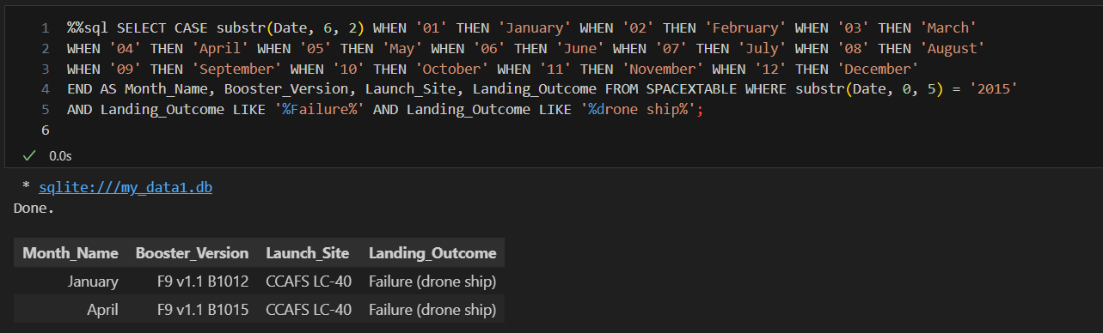
2015 Launch Records
2015 Recorded 7 missions, out of them only 1 successfully landed on December, all the drone ship landing attempts were a failure (January, April), boosters used in 2015 were predominantly V1.1 of falcon 9 launched from cape caraneval.

Slide 33
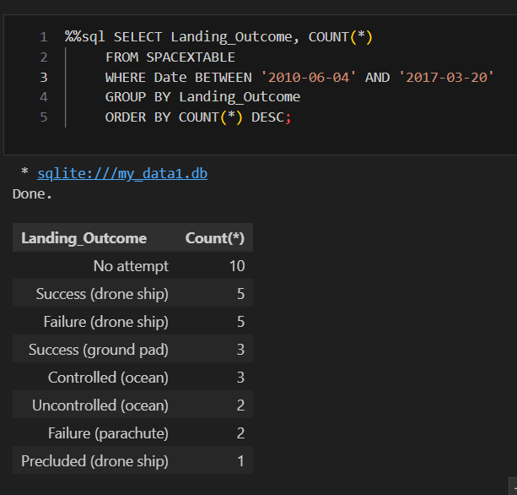
Rank Landing Outcomes Between 2010-06-04 and 2017-03-20
Count of landing outcomes between the date 2010-06-04 and 2017-03-20, in descending order
They predominantly didn’t attempt landings, their first landing success with a falcon 9 booster was recorded in 2015, so total 8 successful landings between December 2015- march 2017.

Slide 34

Section 3

Slide 35
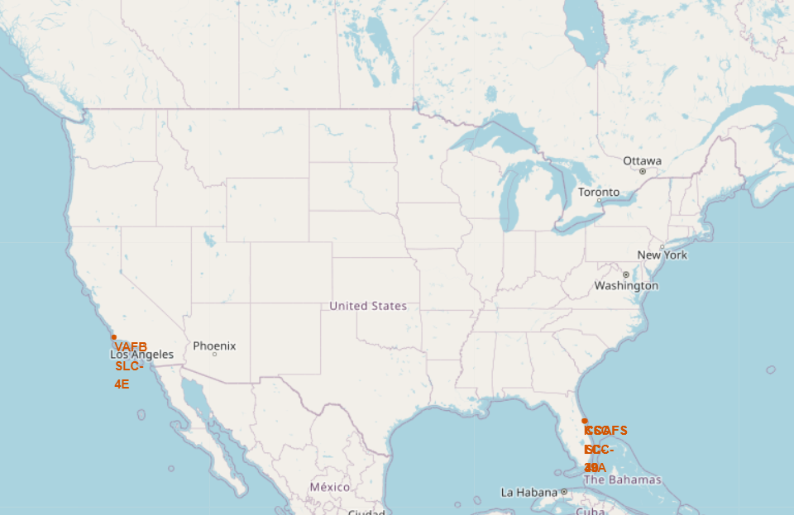
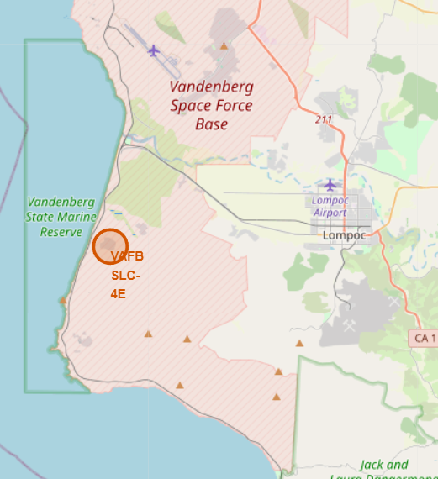
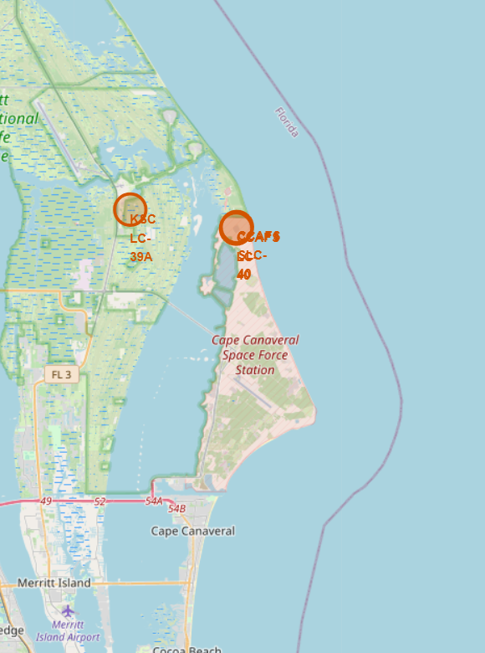
Launch Locations
CAAFS LC-40 (Cape Canaveral Air Force Launch Complex 40) Florida US
VAFB SLC-4E (Vandenberg Air Force Base Space Launch Complex 4 East) Nebraska US
KSC LC-39A (Kennedy Space Center Launch Complex 39A) Florida US
They are situated along the Atlantic and Pacific coast, providing direct access to supply chains and transportation routes. Their coastal location allows for eastward launches over the ocean, westwards for Vandenberg reducing the risk of debris falling over land.

Slide 36
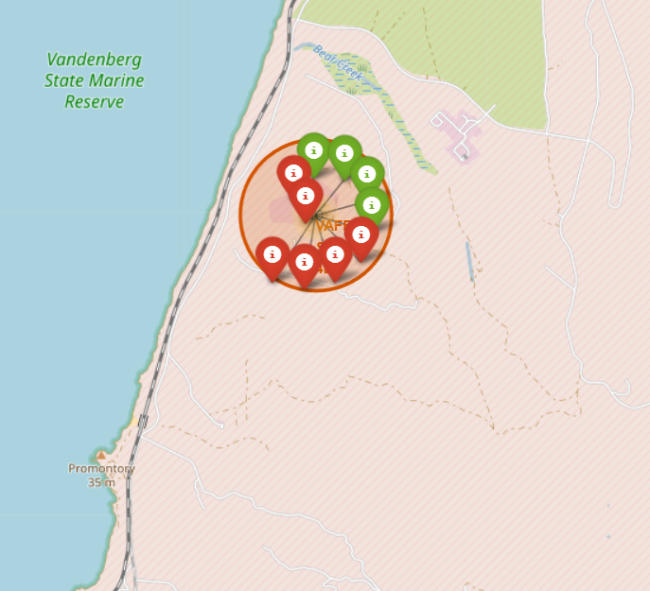
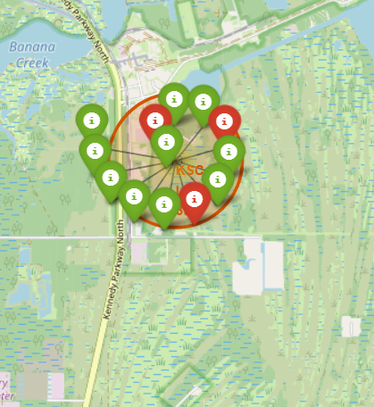
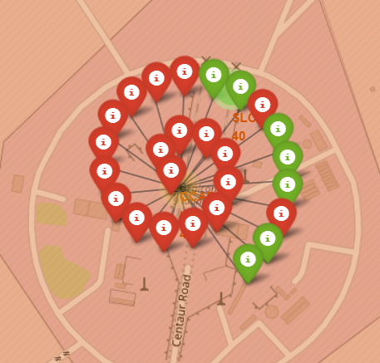
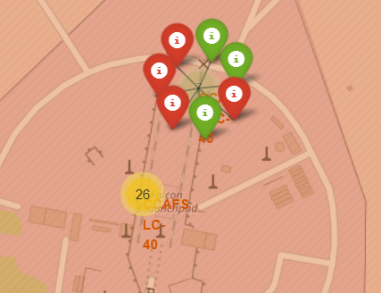
Launch Outcomes in Launch bases
VAFB SLC-4E (Vandenberg Air Force Base Space Launch Complex 4 East) Nebraska US
Total of 10 attempts
Success ratio 2:3
KSC LC-39A (Kennedy Space Center Launch Complex 39A) Florida US
Total of 13 attempts
Success ratio 10:3
CAAFS LC-40 (Cape Canaveral Air Force Launch Complex 40) Florida US
Total of 26 attempts
Success ratio 7:19
CAAFS SLC-40 (Cape Canaveral Air Force Space Launch Complex 40) Florida US
Total of 7 attempts
Success ratio 3:4
Kennedy Space center Florida was mostly successful

Slide 37
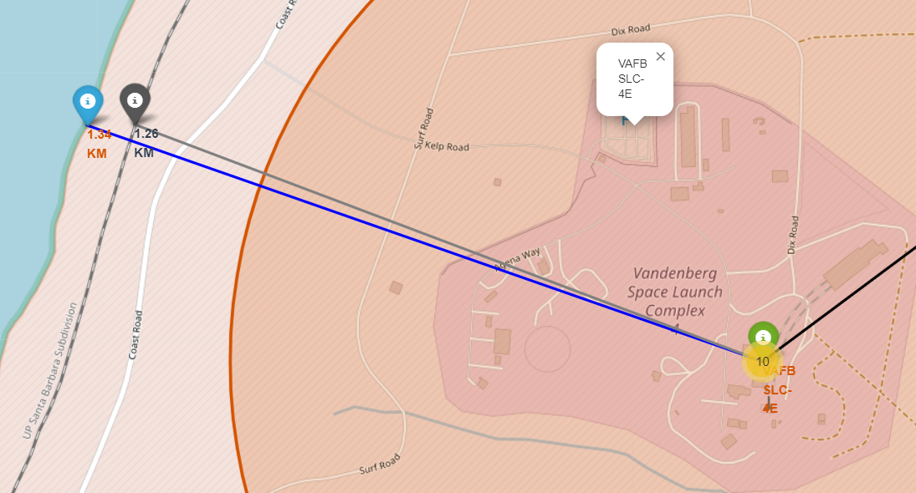
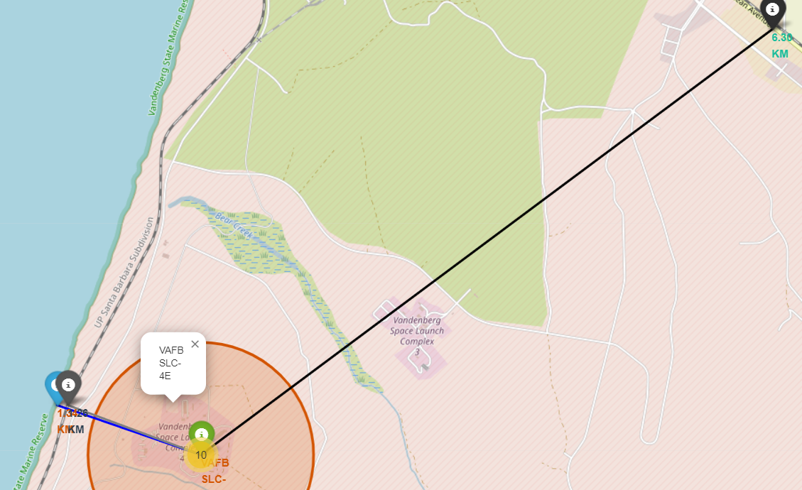
Launch bases distances from coastlines, railways and highways
Closest railway is at a distance of 1.26 Km
Closest Coastline is at a distance of 1.34 Km
Closest Highway is 6.3 Km away
Vandenberg space launch complex taken for calculation

Slide 38

Section 4

Slide 39
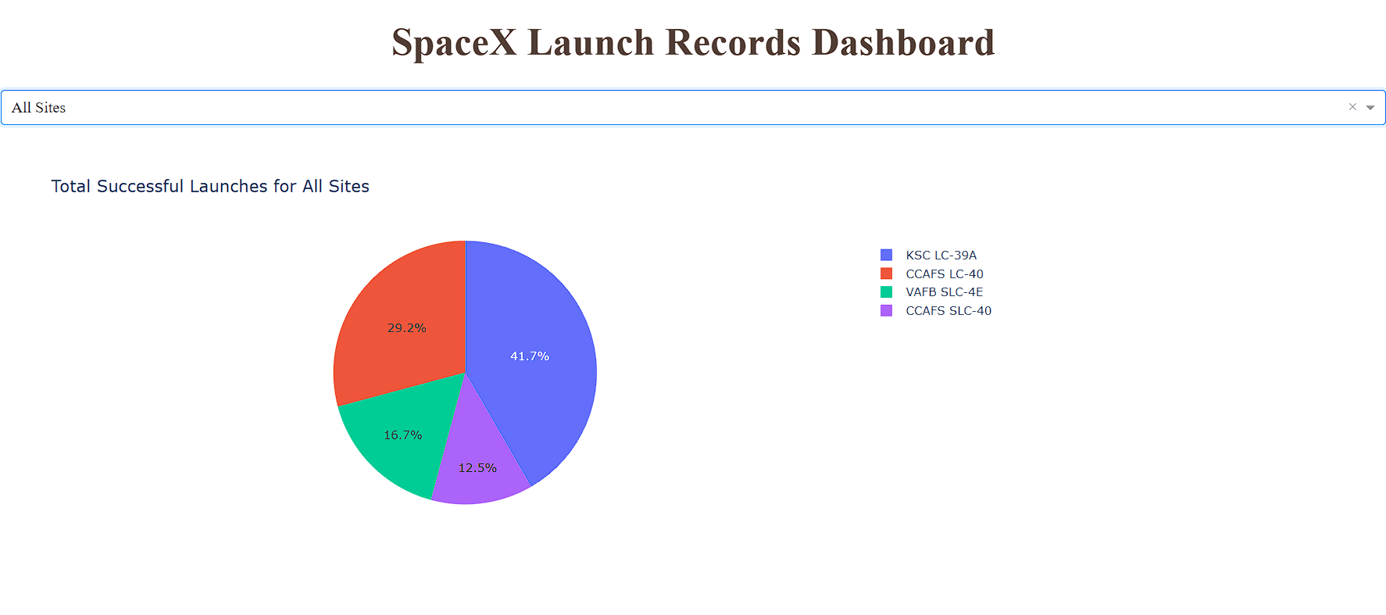
DashBoard for success ratio of each site
KSC LC-39A (Kennedy Space Center Launch Complex 39A) Florida US saw the highest success ratio, followed by Cape Canaveral, they both are located near to each other, while Vandenberg and the Cape Canaveral Space launch saw the least success ratio

Slide 40
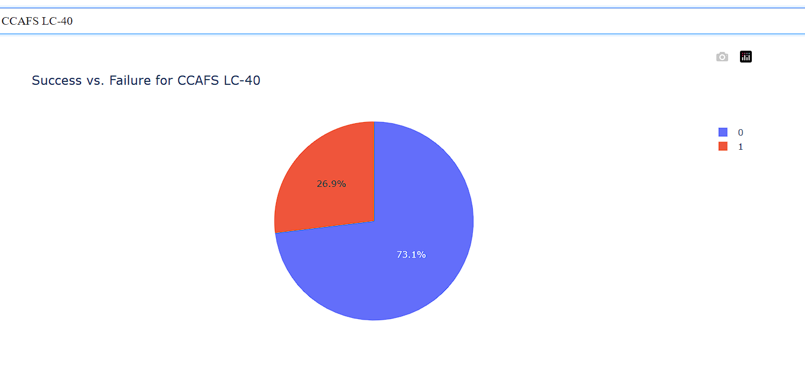
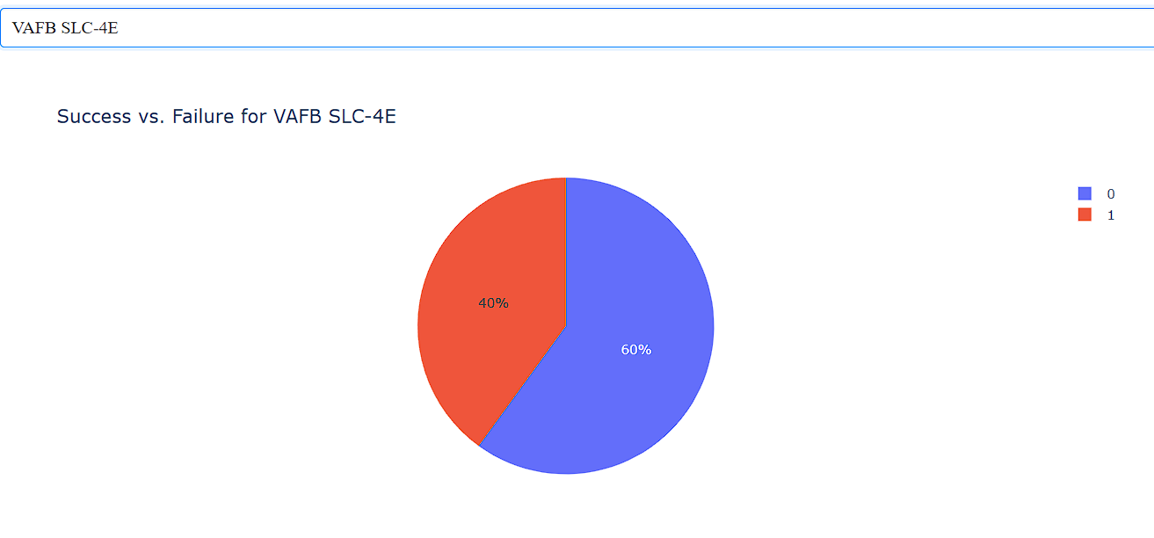
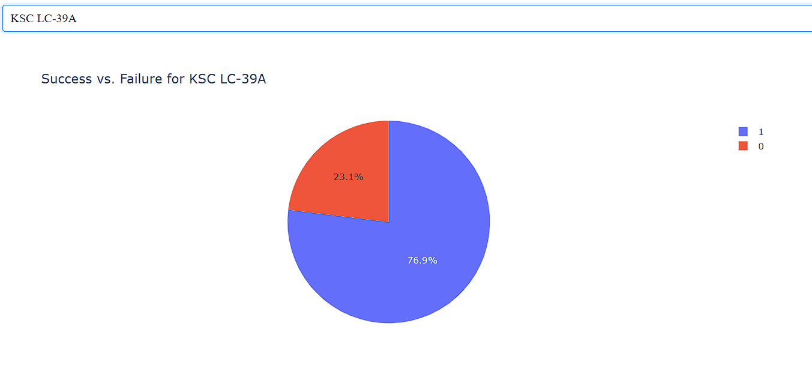
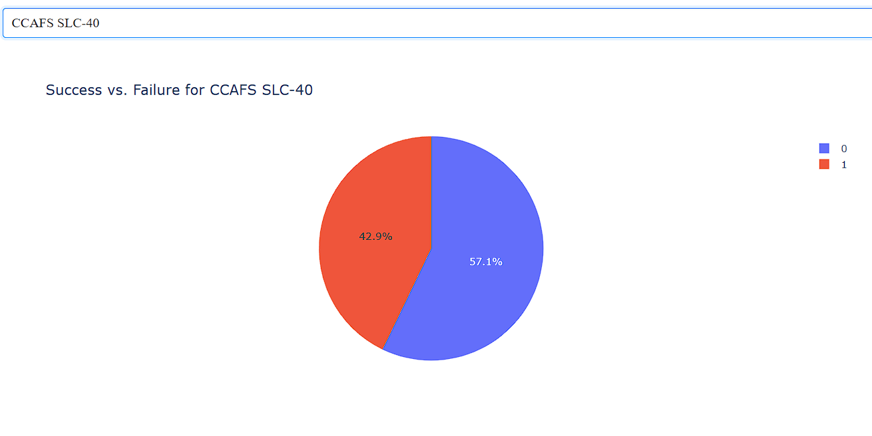
Success Ratio of each site
VAFB SLC-4E (Vandenberg Air Force Base Space Launch Complex 4 East) Nebraska US
KSC LC-39A (Kennedy Space Center Launch Complex 39A) Florida US
CAAFS LC-40 (Cape Canaveral Air Force Launch Complex 40) Florida US
CAAFS SLC-40 (Cape Canaveral Air Force Space Launch Complex 40) Florida US
40

Slide 41
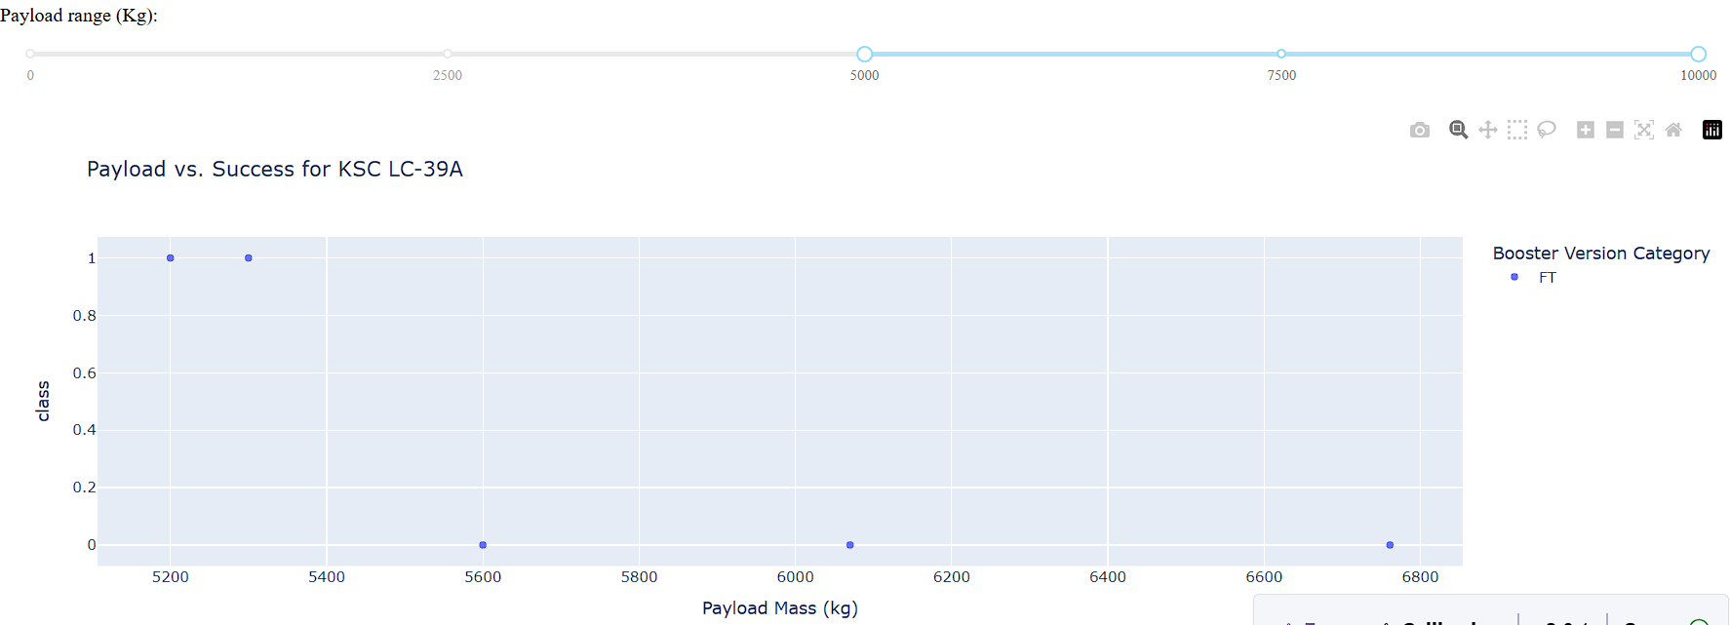
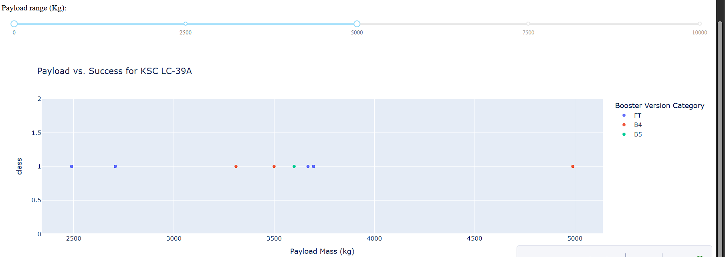
Payload vs Success of various boosters for KSC (Kennedy Space Center)
Higher payloads were carried out by only FT booster of the falcon 9 family, where majority of success was achieved when payload was below 5400 Kg, higher payload resulted in failures
All the payloads below 5000 kg were a success, given that all the 3 of the 5 Booster versions of falcon 9 (FT, B4, B5) were used. Majorly the payload weighed around 3500 Kg, lowest being 2500Kg.

Slide 42

Section 5

Slide 43
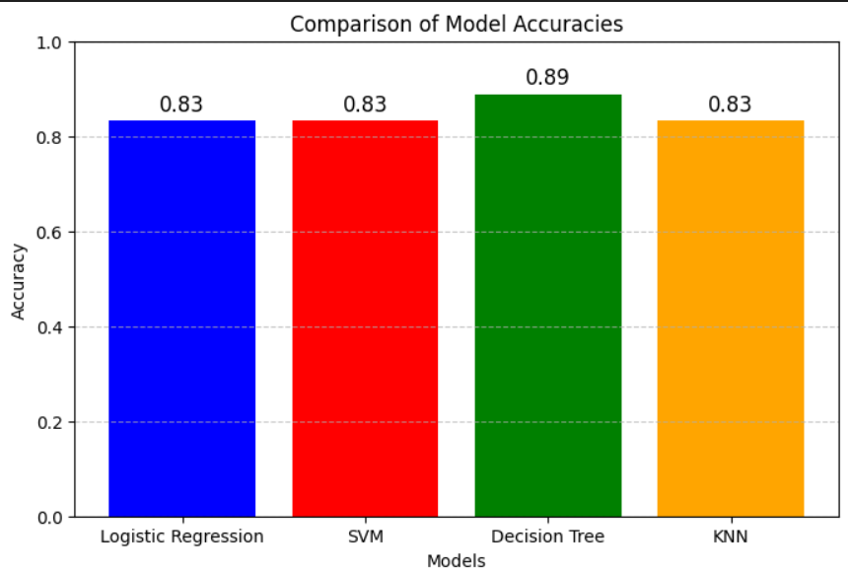
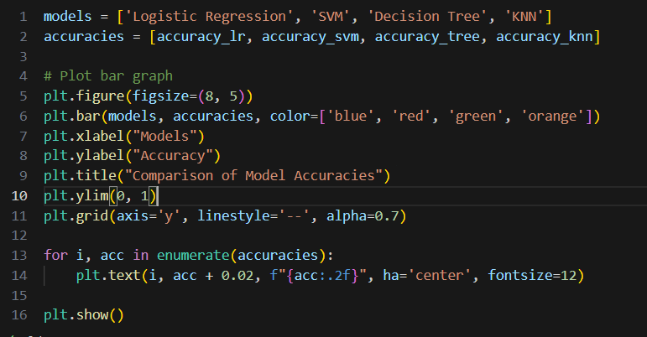
Classification Accuracy
Linear Regression, SVM, KNN all had an accuracy of 83.33% on the test set, whereas Decision Tree had an accuracy of 88.88%.

Slide 44
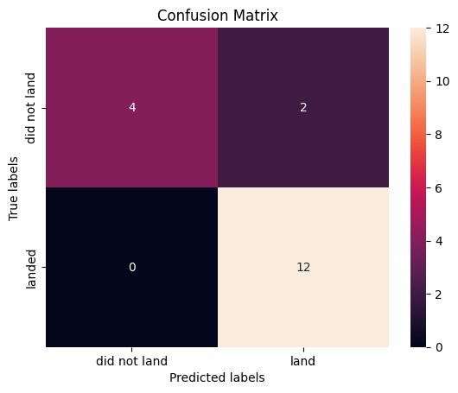
Confusion Matrix of Decision Tree
True Positive (12)
Predicted Label = landed Successfully
Actual Label = landed Successfully
True Negative (4)
Predicted Label = landing Failed
Actual Label = landing Failed
False Positive (2)
Predicted Label = landed Successfully
Actual Label = landing Failed
True Negative (0)
Predicted Label = landing Failed
Actual Label = landing Successfully

Slide 45
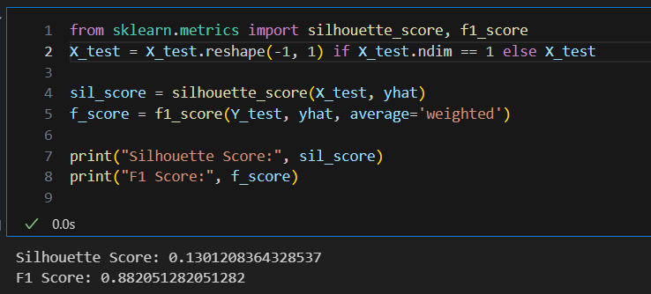
Conclusions
High F1 score suggests that the model is performing well on classification tasks and F1 score varies from 0-1
Low Silhouette Score means that the data is well cluster able and that is the data points lie close to each other in the n-dimensional space. Silhouette score lies between -1 to 1, -1 being the poorest.

Slide 46
Appendix
All relevant data to be found in Github: Yashasvidasi/DataAnalysisCapstone

Slide 47


